Slide 1
Docker Delight
Unlocking the Power of Containerization
Notes:
A conversation, not so much a presentation
Entry-level Docker session
Q: Who has already worked with Docker?
Q: Who works daily with Docker?
Make sure everyone who wants to follow the demos is logged into Play with Docker already!

Slide 2
What are containers?
Containers are standalone executable packages (we’ll focus on Docker)
They contain everything your app needs to run, and no more
Virtualization technology (more on that later) originated on the Linux world.
Notes:
Docker is what runs and manages containers, but Docker is not the only option
It is an open source platform for containerization

Slide 3
Docker concepts
Dockerfile – File with instructions to create an image
Image – Created from the Dockerfile, it contains the filesystem structure
Container – An instance of the image. From the same image you run many containers
Env Variables – Allows us to input config into the container
Port binding – Allows us to communicate with certain ports in the container
Volumes – These are like attaching an external disk to the container. Used for saving data that should survive container destruction
Notes:
Questions on the concepts?

Slide 4
Containers vs VMs
Resource Utilization
Containers: Lightweight with efficient resource utilization.
Virtual Machines: Dedicated resources and higher overhead.
Portability
Containers: Highly portable and easy migration.
Virtual Machines: Somewhat portable but require compatibility with various hypervisors and OS.
Isolation
Containers: Process-level isolation.
Virtual Machines: Strong isolation with separate virtual hardware and OS.
Scalability
Containers: Easy replication and scalability.
Virtual Machines: Potential for horizontal scaling.
Notes:
Ask: who thinks that this looks a lot like VMs?
Talk about 247tailorsteel operations: new factory -> new VMs -> install everything manually (check with Mario, this is better in a future slide)
Resource - Container
Pros: Low resource overhead, reduced duplication of OS.
Resources are used as needed, since containers usually share the same OS kernel.
Cons: Limited OS support, less isolation compared to VMs.
Resource - VM
Pros: Robust isolation.
Cons: Increased resource overhead.
Portability – Container
Pros: Easy deployment, cross-system compatibility.
Cons: Compatibility constraints with container runtime and host OS.
Portability – VM
Pros: Versatility in hypervisor choice.
Cons: Challenges in migration between different hypervisors or host systems.
Isolation – Containers
Pros: Efficient isolation for applications.
Cons: Limited isolation compared to VMs.
Isolation - VMs
Pros: Comprehensive isolation.
Cons: Increased resource overhead.
Scalability – Containers
Pros: Seamless scaling of containers.
Cons: Additional complexity in management and orchestration.
Scalability - VMs
Pros: Scalability options.
Cons: Complexity in management and scaling.

Slide 5
Containers vs VMs
Performance
Containers: Near-native performance with low overhead.
Virtual Machines: Has a performance overhead due to virtualization layer.
Use Cases
Containers: Ideal for microservices and scalable applications.
Virtual Machines: Suitable for running legacy applications.
Notes:
Performance – Containers
Pros: Efficient performance.
Cons: Compatibility constraints with container runtime and host OS.
Performance - VMs
Pros: Capability to run various applications.
Cons: Slower startup and deployment compared to containers.
Use cases – Containers
Pros: Suitable for DevOps practices and CI/CD.
Cons: Limited OS support in some runtimes.
Use cases – VMs
Pros: Support for legacy systems.
Cons: Increased resource overhead.
Finish by saying that you can use both VMs and Containers at the same time.

Slide 6
Reverse Q&A
Notes:
Why use volumes in Docker?
Why use port bindings?
Why is a Docker Container so much lighter than a VM?

Slide 7
Concepts in the real world
Notes:
Demo with real food. Try some food with no plate
-> More food coming to the table
-> Dependencies mixing up
-> Windows update messing everything up

Slide 8
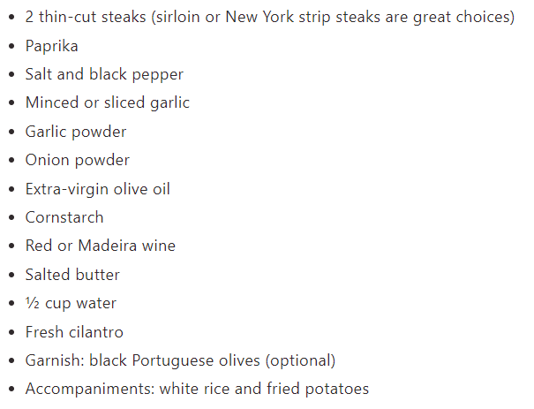
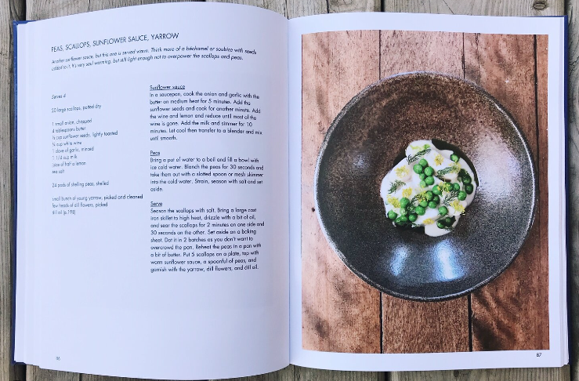

Docker vs food
Recipe -> Dockerfile + Image
Food -> App + dependencies
Cookbook -> Registry
Plate -> Container
Table -> Host

Slide 9
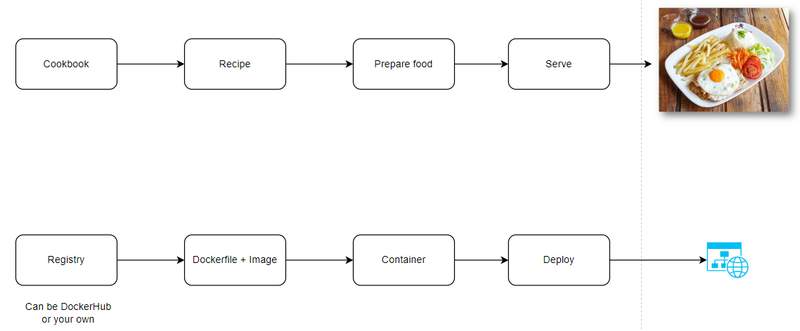
Creating a container is like cooking

Slide 10
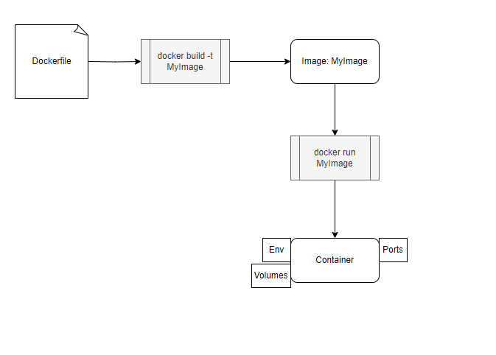
Docker workflow
Notes:
Docker is what runs and manages containers, but Docker is not the only option
It is an open source platform for containerization

Slide 11
Demo time folder: 01-docker-demo
Notes:
Get on Play with Docker

Slide 12
When using Docker you get…
Isolation – Your Docker container contains exactly what it needs, no more no less.
Repeatability – Spinning up a container is like starting from scratch.
Performance – Containers are more lightweight compared to other virtualization tech.
Portability – Your container will run wherever Docker is supported
Discardability - Containers are ephemeral. If the container dies it will start from scratch
Immutability - Images are immutable, meaning a new version of an application is a new image
Notes:
On Isolation -> What happens over time when you don’t have isolation?
Why is immutability a good thing for a container?

Slide 13
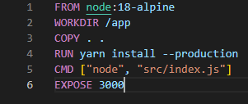
Inside a Dockerfile
Base image
Copy app content to image
Install dependencies
Define the start command
You always start from a base image
Each line on the Dockerfile is a layer on the resulting image
You can run arbitrary commands to install tools on your image
Notes:
What does a base image contain? How do we find out?
An image is a bunch of layers, just like a cake

Slide 14
Hands-on: inside a container folder: 02-inside-a-container
Notes:
Get on Play with Docker

Slide 15
Container inputs and outputs
Input – Environment variables
Input/Output – exposed ports
Input/Output - volumes
Notes:
Why do we care about inputs and outputs in containers?

Slide 16
Hands-on: demos from registry folder: 03-demos-from-registry
Notes:
Get on Play with Docker

Slide 17
Tooling
Docker CLI
Docker Desktop
Portainer
VS Code – Dev containers
Docker Compose

Slide 18
Orchestration
From one container to a whole system

Slide 19
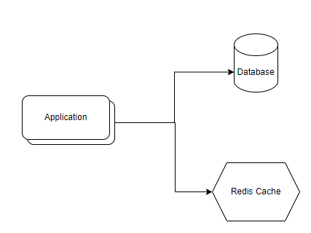
Running whole systems
Notes:
What is orchestration?
Why do we need it?
Builds up on top of Docker
What orchestrators exist? Docker Compose (for dev), Docker Swarm, Kubernetes

Slide 20
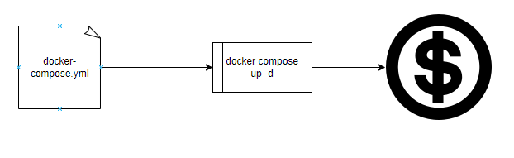
Docker Compose Workflow
Notes:
Docker compose file allows for clear definition of the system
Instead of typing commands on the command line we define the system in a compose file

Slide 21
Hands-on: running a whole system folder: 04-docker-compose-demo
Notes:
Open ports 5000 and 5001

Slide 22
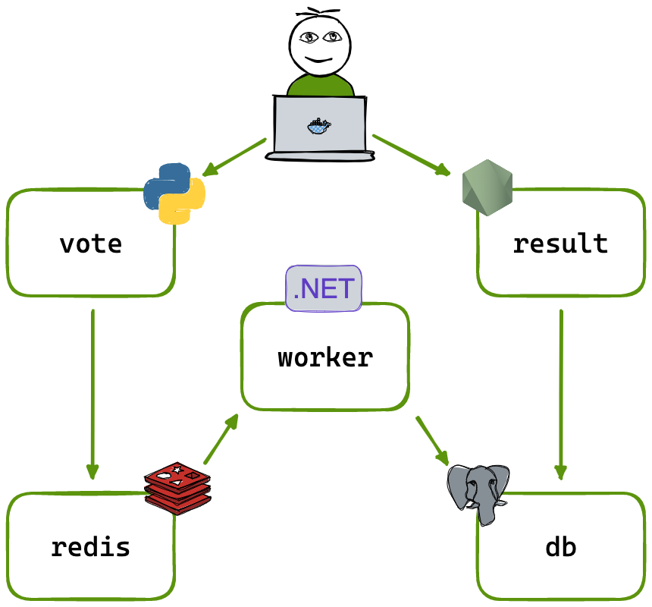
What just happened?
Notes:
Multiple services were created. Each one running on different technologies
Docker created networks to isolate the communication
Created a volume to persist the data. In case the Db container dies the data persists.

Slide 23
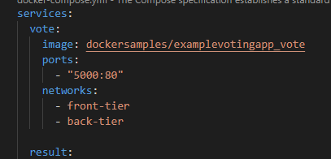
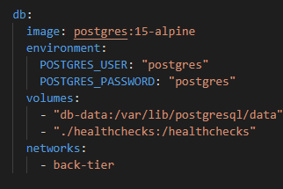
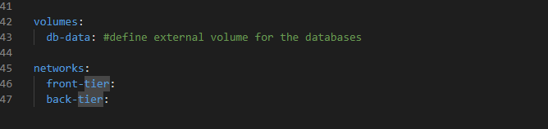
Inside a docker-compose file
Notes:
Check this out on VS-Code

Slide 24
Getting your app ready for Docker
Create a Dockerfile for your app
Check the 12 factor principles
Change your CI/CD to work with Docker
Describe your system in a Docker Compose
Notes:
It is possible to simply lift and shift (copy the app executables directly to the container and use that)

Slide 25
What does CI/CD look like with Docker?
“docker build” your image
“docker push” your image to your registry
Deploy the image on your service.
Notes:
On Isolation -> What happens over time when you don’t have isolation?

Slide 26
Real use-case – 247TailorSteel
Notes:
Open ports 5000 and 5001

Slide 27
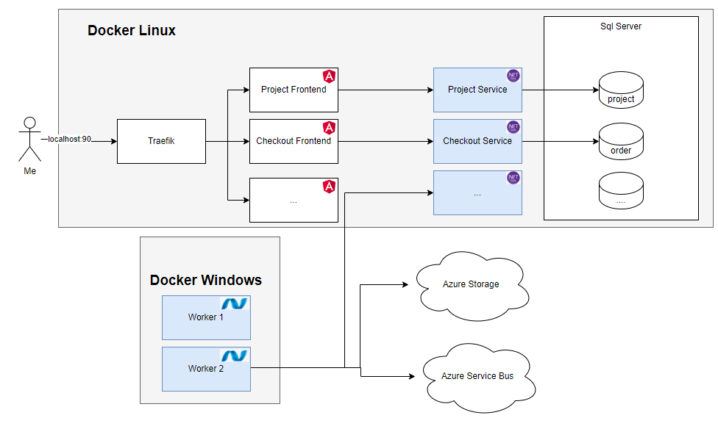
Our architecture
Notes:
Different technologies on the same project
Everything runs local except cloud services
Running Windows and Linux containers simultaneously

Slide 28
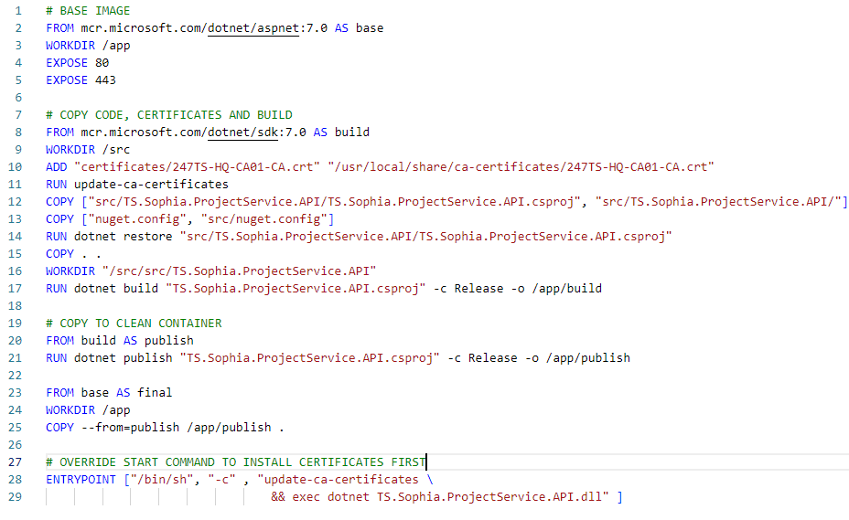
Typical Dockerfile
Notes:
Different technologies on the same project
Everything runs local except cloud services
Running Windows and Linux containers simultaneously

Slide 29
Docker compose file
Linux Docker compose file
Windows Docker compose file
Notes:
On Isolation -> What happens over time when you don’t have isolation?

Slide 30
Benefits
Environment very similar to prod
Total independence in the team
Up and running in a couple of minutes
Notes:
On Isolation -> What happens over time when you don’t have isolation?

Slide 31
Dev experience – risky demo of the day
Start the whole system locally
Stop the container you will be developing on
Configure the service locally with your variables
Make your changes on a local branch
Push to the CI branch
After the CI everyone will be able to have your changes locally
Deployment to PROD is the same, but with a merge to main instead of the CI branch
Notes:
On Isolation -> What happens over time when you don’t have isolation?

